Slide 1
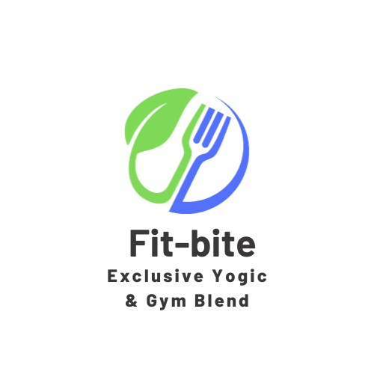
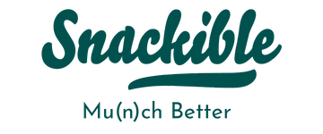
Marketing Management Project
Avijit Biswas

Slide 2
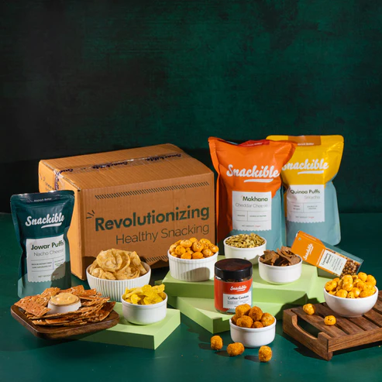

Introduction
'Snackable’ is a health-conscious snack brand dedicated to providing nutritious and delicious snack options for individuals pursuing a healthy and active lifestyle.
There’s growing demand for convenient and wholesome snacks in the yoga and gym community

Slide 3



Market summary
Market Opportunity:
Booming health and wellness sector. Projected $800 billion global yoga and fitness market by 2025.Prime market opportunity for "Snackable for Yoga and Gym.“
Product Line:
Tailored products for yoga and gym enthusiasts. Diverse snack selection: protein bars, trail mixes, energy bites, and hydration beverages
Cost:
Our product cost is low, which gives us a market advantage.

Slide 4
Current Market Situation
Indian Market overview:
In 2022, the size of the Indian snack market was INR 38,603 Crore. Looking ahead, IMARC Group projects that the market will grow at a compound annual growth rate (CAGR) of 10.4% from 2023 to 2028, reaching INR 70,731 Crore.
Segmentation:
Market Segmentation: based on common characteristics, needs, and behaviours.
Behavioural Segmentation: buying habits, usage frequency, and brand loyalty.
Health and Dietary Preferences: dietary restrictions, nutritional preferences, and health-consciousness.
.
Target Customers:
Active yoga practitioners, gym goers, and other fitness enthusiasts between the ages of 18 and 45, working adults who are looking for quick, wholesome snack options.

Slide 5
Competitor Analysis (Competitor Product Analysis)
Patanjali:
Known for manufacturing and selling products like ayurvedic medicines, herbal supplements etc.
Yogabar:
Known for their protein bar, protein muesli, high protein oats etc.
.
Muscle Blaze:
Known for whey proteins and health foods like protein muesli and oats.

Slide 6
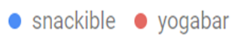
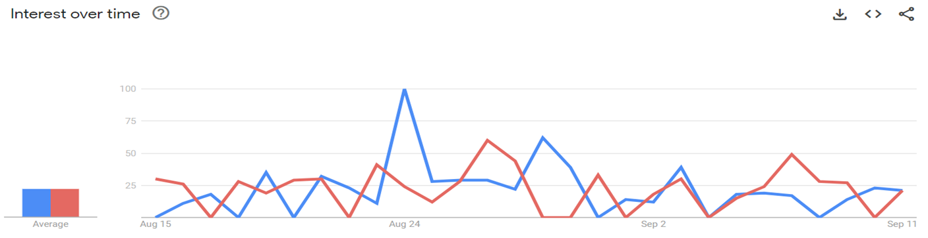

Slide 7
Swot Analysis
Strengths:
Snackible's established brand reputation and recognition.The company has a well-developed distribution network, ensuring efficient product availability in various markets.
Weaknesses:
Potential internal challenges related to resource allocation and budget constraints for marketing and product development.
.
Opportunities:
The growing trend towards healthier snacking options presents an opportunity for Snackable to introduce a product that caters to health-conscious consumers
Threats: -
Fierce competition in snacking industry. Pricing pressures and market saturation. Fluctuations in commodity prices and supply chain disruptions affecting costs and availability

Slide 8
Market Objective
Increase Sales:
Use limited-time promotions and discounts to attract early adopters and price-sensitive consumers.Collaborate with complementary brands for bundled offerings and joint promotions to expand the customer base.
Build Brand Awareness:
Create informative and entertaining content to educate consumers about snacking culture and trends. Sponsor relevant events and host in-person and virtual engagements to showcase the product and engage with potential customers.
Marketing Strategy:
Product Differentiation: Highlight unique features and benefits to stand out from competitors.Social Media Advertising: Run targeted ad campaigns on platforms like Facebook, Instagram, and Twitter.

Slide 9
Ansoff matrix: This matrix represents that our product is currently at the product development stage.
 | Existing Market | New Market
Existing Product | Market Penetration | Product Development
New Product | Market Development | Diversification Strategy

Slide 10

Positioning
Positioning Statement:
For Protein Bars (Gym Enthusiasts): "Want a snack, but not your cheat day yet? At Snackible, we've crafted the ultimate snack for Gym Enthusiasts - our protein bars.”
For Aloe Juice (Yoga Practitioners): "At Snackible, our Aloe Juice is your trusted companion on your yoga journey.

Slide 11


Value Proposition

Slide 12
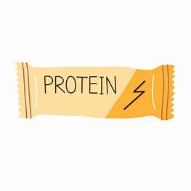

Value Proposition:
For Protein bars:
High-Quality Protein and good taste: Our protein bars pack a potent protein punch that helps muscles grow and repair after challenging workouts. Ditch the tasteless, chalky protein bars.
For Aloe juice:
Pure Aloe Vera and Hydration: Our aloe juice is produced using only pure aloe vera, which is well-known for its relaxing and restorative effects and is perfect for yoga practitioners. Aloe juice naturally keeps you hydrated.
.

Slide 13
4-Ps Protein bars:
Product:
Location:
Snackible’s protein bars are intended for fitness enthusiasts. They are delicious, made using premium protein sources, and packed for easy consumption while traveling.
Location: Our online store, gyms, fitness centres, and health stores will all carry these protein bars as part of our distribution strategy
Price
Promotion:
Snackible has set its protein bars at a fair price so that gym enthusiasts may get value for their money. Pricing is chosen such that it reflects the value and quality of the product while still being affordable to the target market.
Snackible's promotional activities include social media marketing campaigns that target gym enthusiasts, fitness publications, and partnerships with fitness influencers.

Slide 14
4-Ps Aloe juice:
Product:
Location:
Aloe juice from Snackible is marketed to yoga practitioners as being natural and pure.
Aloe Juice is priced competitively while still reflecting the excellent quality and advantages it provides to yoga practitioners.
Price
Promotion:
Our online store, a few health stores, yoga studios, and wellness centres all carry the product.
Snackible uses marketing strategies that connect with yoga practitioners to sell its aloe juice. The promotion will be done through partnerships with yoga instructors, wellness events, and online content.

Slide 15
Control A control strategy is a plan of action that is designed to manage and mitigate risks or potential problems that may arise in the production, distribution, or promotion of an energy drink
. Survey
Feedback
.
Product performance review

Slide 16
Financials table (Budget)
Categories | Cost
Market Research | 40000
Production cost(PPE) -Gym product -Yoga product | 500*0.6*1000=300000 180*0.4*1000=200000
Advertisement and Promotion | 100000
Distribution | 1,70,000
Others(fixed cost) | 1,00,000
Total | 9,10,000
Per month cost
Break even = 727 units of product

Slide 17

Thankyou!

